Slide 1
Person Name Disambiguation by Bootstrapping SIGIR’10
Yoshida M., Ikeda M., Ono S., Sato I., Hiroshi N.
Supervisor: Koh Jia-Ling Presenter: Nonhlanhla Shongwe Date: 2010-11-23

Slide 2
Preview
Introduction
Two stage clustering Algorithm
First stage clustering
Second stage clustering
Experiments
Evaluation measures
Results
Conclusion

Slide 3
Introduction
World Wide Web(www)
Used for learning about real-world entities e.g people
Problem
Ambiguity in names
This causes the search results to contain web pages about several different entities

Slide 5
Introduction cont’s
First typical approach
Define similarities between documents based on features extracted from the documents
Cluster Web pages returned by search engines for person name queries by using the similarity
Use Named Entities (NE’s)

Slide 6
Introduction cont’s
Named Entities (NE)
Good feature for distinguishing people
Represent real-world concepts related to the people
e.g. Microsoft is related to Bill Gates
Compound Key (CKW) words and URL’s
Similar properties like NE’s
e.g. CKW: chief software architect indicate Bill Gates
Challenge
Show high precision values and low recall values

Slide 7
Introduction cont’s
Second typical approach
Use weak features for calculation of document similarities
2 categories to represent a document
Strong features e.g. NE, CKW, URL
Ability to clearly distinguish between clusters
Weak features e.g. single words
No ability to clearly distinguish between clusters.
Challenges
Improves the recall but worsens the precision

Slide 8
Two stage clustering algorithm
First stage clustering algorithm
Use the strong features to represent documents
E.g. NE, CKW , URL’s
Second stage clustering algorithm
Use bootstrapping to extract instances (weak features)
E.g. words
For example
A computer scientist and baseball player share the same name
Computer scientist->memory and algorithm
Baseball -> ball and battling

Slide 9
First stage clustering algorithm
Extract 3 types of strong features
Named entities
Compound key words
URL’s
Named Entities features
Person names (used as is)
Organization names (filtered out)
Place names (filtered out)
Notes:
A Tree Tagger was used to add the part of speech tags.
A Stanford NER was used for identifying person, place and organization names.

Slide 10
First stage clustering algorithm cont’s
Compound key word features
Calculate the importance score for compound words in a document
CW means compound word
CW = (W1, W2…. WL) where Wi is a simple noun
f(CW) = number of independent occurrences of CW in a document
Independent means CW is not part of a longer CW

Slide 11
First stage clustering algorithm cont’s
Example
“Data mining is the process of extracting patterns from data. Data mining is seen as an increasingly important tool by modern business to transform data into business intelligence giving an informational advantage”
f(CW) of the compound word of data and data mining
f(data) = 2
f(data mining) = 2

Slide 12
First stage clustering algorithm cont’s
Compound key word features
where
frequencies of nouns that
LN(Wi)- precede simple noun Wi
RN(Wi)- succeed simple noun Wi

Slide 13
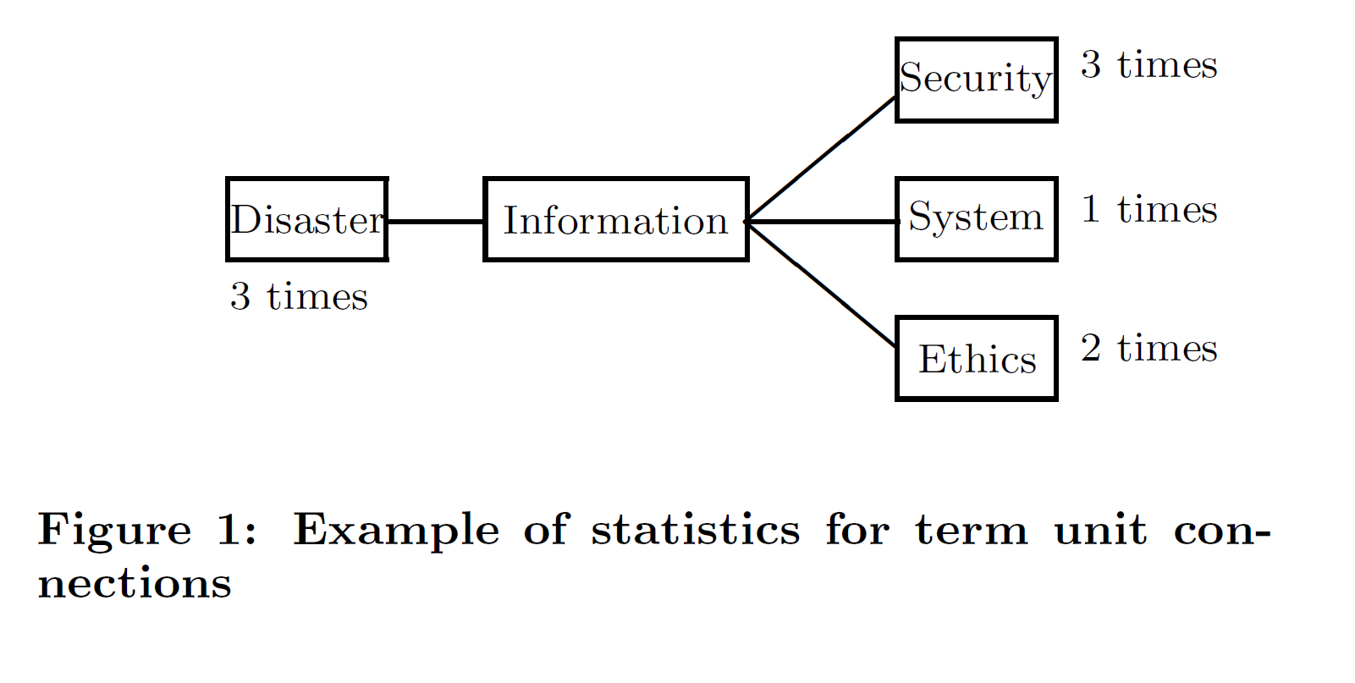
First stage clustering algorithm cont’s
Compound key word features
f(Information) = 9
LN(Information) = 3
LR(Information)= 3+1+2=6
LR(information, security) = {(3+1)(6+1)} x {(3+1)(2+1)}
= (28x12)^1/4
= 4.28
Score(information security) = 3* 4.28= 12.84
f(security) = 3
LN(Security) = 3
LR(Security)= 2

Slide 14
First stage clustering algorithm cont’s
Link Features
Extract URLs (in <a>tags) from each document
Use them as link features
Include the URL of the document itself
Filtered out stop words

Slide 15
First stage clustering algorithm cont’s
Document similarity
How to calculate document similarities using the extracted features
fx and fy are sets of features extracted from documents dx and dy
Θoverlap is a threshold value to avoid too small denominators
Calculate similarities by
NEs (simNE)
CKWs (simCKW)
Calculate similarity of URLs (simURL)

Slide 16
First stage clustering algorithm cont’s
 | Document 1 | Document 2 | Document 3
NE: | Steve Jobs, Pixar, Disney, Apple, Macintosh | Bill Gates, Microsoft | George Bush, white house
CKW: | American business magnate, CEO, computer | American business magnate, Chief Software Architect, Computer, CEO | President, CEO, oil business, republican
URL: | fastcompany.com | fastcompany.com | Wikipedia.com
 | Overlap(D1, D2) | Overlap(D1, D3) | Overlap(D2, D3)
Sim(NE) | 0 | 0 | 0
Sim(CKW) | ¾=0.75 | ¼=0.25 | 0.25
Sim(URL) | 1 | 0.25 | 0.25

Slide 17
First stage clustering algorithm cont’s
Calculation of merged similarities
Different similarity scores are calculated for different types of named entities
Person names
Location names
Organization names
αp = 0.78 αL= 0.16 αo=0.06

Slide 18
First stage clustering algorithm cont’s
Merging different similarities: for NE, CKW and LINK
Calculated by taking the maximum of the given similarity values
Sim max(D1, D2) = max(0, 0.75, 1)=1
Sim max(D1, D3)= max(0, 0.25, 0.25)= 0.25
Sim max(D2, D3)= max(0, 0.25, 0.25)= 0.25

Slide 19
First stage clustering algorithm cont’s
Clustering algorithm
Used standard hierarchical agglomerative clustering(HAC ) algorithm
Start with one-in-one clustering and merges the most-similar cluster pairs
Used the average clustering approach

Slide 20
Second stage clustering algorithm
Used Bootstrapping
Used to extract a set of instances (e.g. country names finds
“ *’s prime minister”)
Espresso was used to find in documents word pairs that have relations
Uses a HITS-like matrix multiplication
Notes:
Espresso finds in document word pairs that have relations similar to the given seed pairs
It extracts instances and extraction patterns iteratively and selects the instances and a patterns according to the reliability function defines bases in self-mutual-information values
They tried to apply this method to the person name disambiguation problem

Slide 21
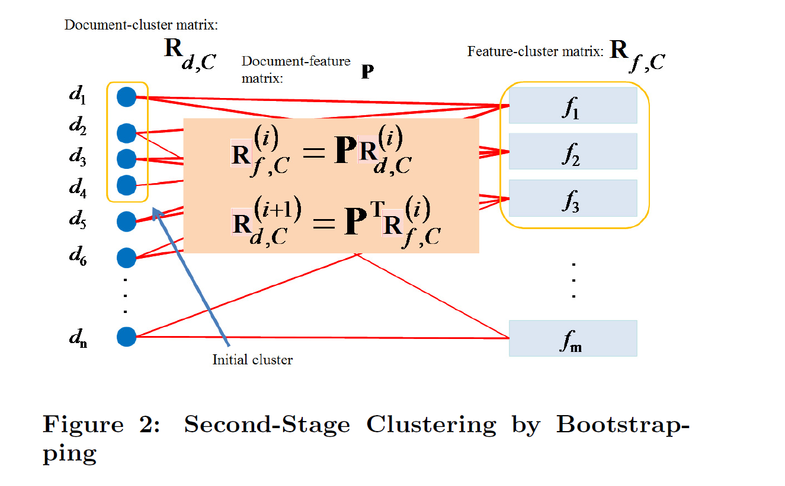
Second stage clustering algorithm cont’s
Notes:
Define a feature-document matrix P (relation of the ith feature and j document)
Explains the meaning of the matrix multiplication
Feature fi is connected to document dj if fi is contained to dj
If a document belong to a cluster, the document =1, to that cluster.
Such information is propagated to the feature-cluster matrix through the document-feature matrix P
Feature cluster weights are obtained by multiplying document cluster matrix with P
Features strongly related to cluster K, are given higher weights.
New document cluster matrix is obtained by multiplying the feature cluster matrix and the P transpose

Slide 22
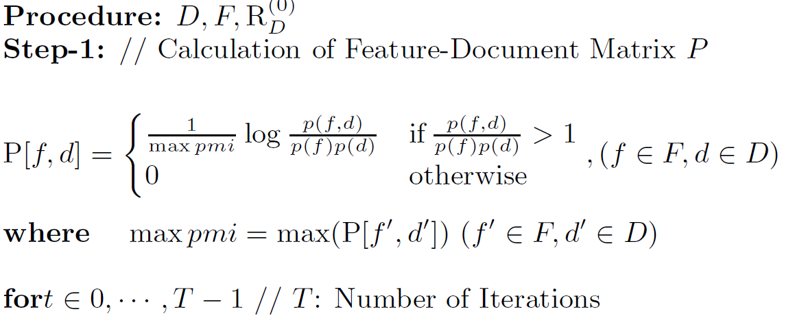
Second stage clustering algorithm cont’s
Algorithm (STEP 1)
A feature-document matrix P is generated.
d1 d2 d3 d4
f1 1 1 1 1
f2 1 0 1 0
f3 0 1 0 0
f4 1 0 1 1
C1 C2
d1 1 0
d2 1 0
d3 0 1
d4 0 1
=
P(f,d) =

Slide 23
Second stage clustering algorithm cont’s
Algorithm (STEP 2)
A feature-cluster matrix ( )is calculated from P and current document-cluster matrix( )
d1 d2 d3 d4
f1 1 1 1 1
f2 1 0 1 0
f3 0 1 0 0
f4 1 0 1 1
C1 C2
d1 1 0
d2 1 0
d3 0 1
d4 0 1
C1 C2
f1 0.5 0.5
f2 0.25 0.25
f3 0.25 0
f4 0.25 0.5
x
=
P(f,d) =
=

Slide 24
Second stage clustering algorithm cont’s
Algorithm (STEP 3)
A document-cluster matrix ( )is calculated from P and the current feature-cluster matrix
f1 f2 f3 f4
d1 1 1 0 1
d2 1 0 1 0
d3 1 1 0 1
d4 1 0 0 1
C1 C2
f1 0.5 0.5
f2 0.25 0.25
f3 0.25 0
f4 0.25 0.5
C1 C2
d1 0.25 0.31
d2 0.19 0.13
d3 0.25 0.31
d4 0.19 0.25
x
=
P(T)=

Slide 25
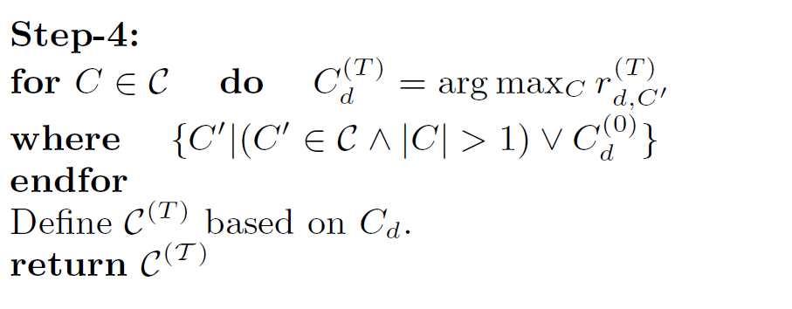
Second stage clustering algorithm cont’s
Algorithm (STEP 4)
C1 C2
d1 0.25 0.31
d2 0.19 0.13
d3 0.25 0.31
d4 0.19 0.25

Slide 26
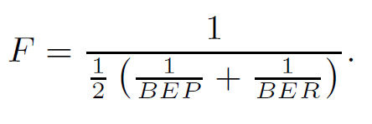
Experiments
Evaluation measures
L(e) = collect class
C(e) = machine-predicted class
Extended B-Cubed precision(BEP) and recall (BER)

Slide 27
Experiments cont’s
Baseline
All-in-one: all documents belong to one cluster
One-in-one :when one document is a size-one cluster
Combined : mixture of the two
Second Stage Clustering
TOPIC: estimates latent topic using a probabilistic generative model
CKW: extracts CKW from the resulting first stage clusters
Bootstrap
Used unigram and bigram features excluding stop words and TF-IDF score was used to calculate the weights for each feature
Notes:
30 names, each of which has 150 pages

Slide 28
Conclusion
Introduced a problem caused my name ambiguity
Explained a two stage clustering method
First stage clustering using HAC
Second stage clustering using Bootstrapping
Explained results showing that this method out performs other previously proposed methods

Slide 29
Thanks you for listening

